Slide 1
Introduction
BERT was created and published in 2018 by Jacob Devlin and his colleagues from Google . It stands for Bidirectional Encoder Representations from Transformers
Bert is designed to pre-train deep bidirectional representations from unlabeled text by jointly conditioning on both left and right context. As a result, the pre-trained BERT model can be fine-tuned with just one additional output layer to create state-of-the-art models for a wide range of NLP tasks.”

Slide 2
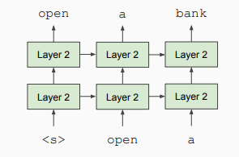
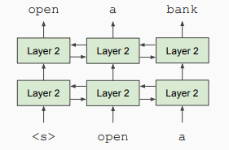
Why Bi-directional Model?
Unidirectional context Build representation incrementally
While in Bidirectional context words can “see themselves”

Slide 3
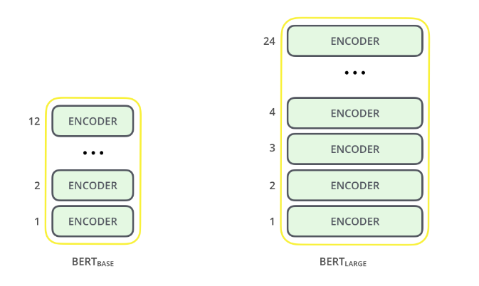
Architecture
The BERT architecture builds on top of Transformer. We currently have two variants available:
BERT Base: 12 layers (transformer blocks), 12 attention heads, and 110 million parameters
BERT Large: 24 layers (transformer blocks), 16 attention heads and, 340 million parameters

Slide 4
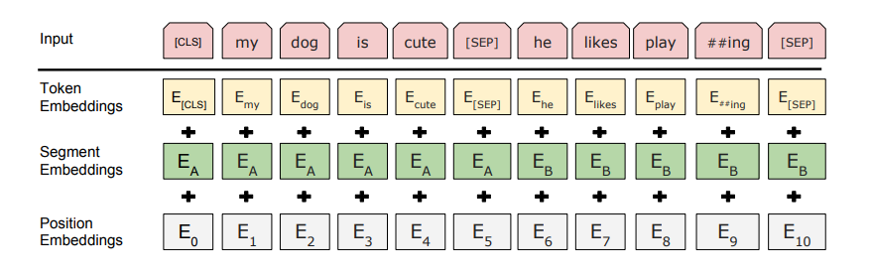
Text Preprocessing

Slide 5
Text Preprocessing
The developers behind BERT have added a specific set of rules to represent the input text for the model. Many of these are creative design choices that make the model even better.
For starters, every input embedding is a combination of 3 embeddings:
Position Embeddings: BERT learns and uses positional embeddings to express the position of words in a sentence. These are added to overcome the limitation of Transformer which, unlike an RNN, is not able to capture “sequence” or “order” information
Segment Embeddings: BERT can also take sentence pairs as inputs for tasks (Question-Answering). That’s why it learns a unique embedding for the first and the second sentences to help the model distinguish between them. In the above example, all the tokens marked as EA belong to sentence A (and similarly for EB)
Token Embeddings: These are the embeddings learned for the specific token from the WordPiece token vocabulary

Slide 6
Pre-training Tasks
BERT is pre-trained on two NLP tasks:
Masked Language Modeling
Next Sentence Prediction
The objective of Masked Language Model (MLM) training is to hide a word in a sentence and then have the program predict what word has been hidden (masked) based on the hidden word's context.
The objective of Next Sentence Prediction training is to have the program predict whether two given sentences have a logical, sequential connection or whether their relationship is simply random.

Slide 7

Masked Language Modeling
The Bert network effectively captures information from both the right and left context of a token from the first layer itself and all the way through to the last layer.
Traditionally, we had language models either trained to predict the next word in a sentence (right-to-left context used in GPT) or language models that were trained on a left-to-right context. This made our models susceptible to errors due to loss in information.

Slide 8
Masked Language Modeling

Slide 9
Masked Language Modeling
The authors of BERT also include some caveats to further improve this technique:
To prevent the model from focusing too much on a particular position or tokens that are masked, the researchers randomly masked 15% of the words
The masked words were not always replaced by the masked tokens [MASK] because the [MASK] token would never appear during fine-tuning
So, the researchers used the below technique:
80% of the time the words were replaced with the masked token [MASK]
10% of the time the words were replaced with random words
10% of the time the words were left unchanged

Slide 10
Next Sentence Prediction
To learn relationships between sentences, predict whether Sentence B is actual sentence that proceeds Sentence A, or a random sentence
Sentence A = The man went to the store.
Sentence B = He bought a packet of chips.
Label = IsNextSentence
Sentence A = The man went to the store.
Sentence B = Penguins are flightless
Label = NotNextSentence

Slide 11
Next Sentence Prediction
Since it is a binary classification task, the data can be easily generated from any corpus by splitting it into sentence pairs. Just like MLMs, the authors have added some caveats here too. Let’s take this with an example:
Consider that we have a text dataset of 100,000 sentences. So, there will be 50,000 training examples or pairs of sentences as the training data.
For 50% of the pairs, the second sentence would actually be the next sentence to the first sentence
For the remaining 50% of the pairs, the second sentence would be a random sentence from the corpus
The labels for the first case would be ‘IsNext’ and ‘NotNext’ for the second case

Slide 12
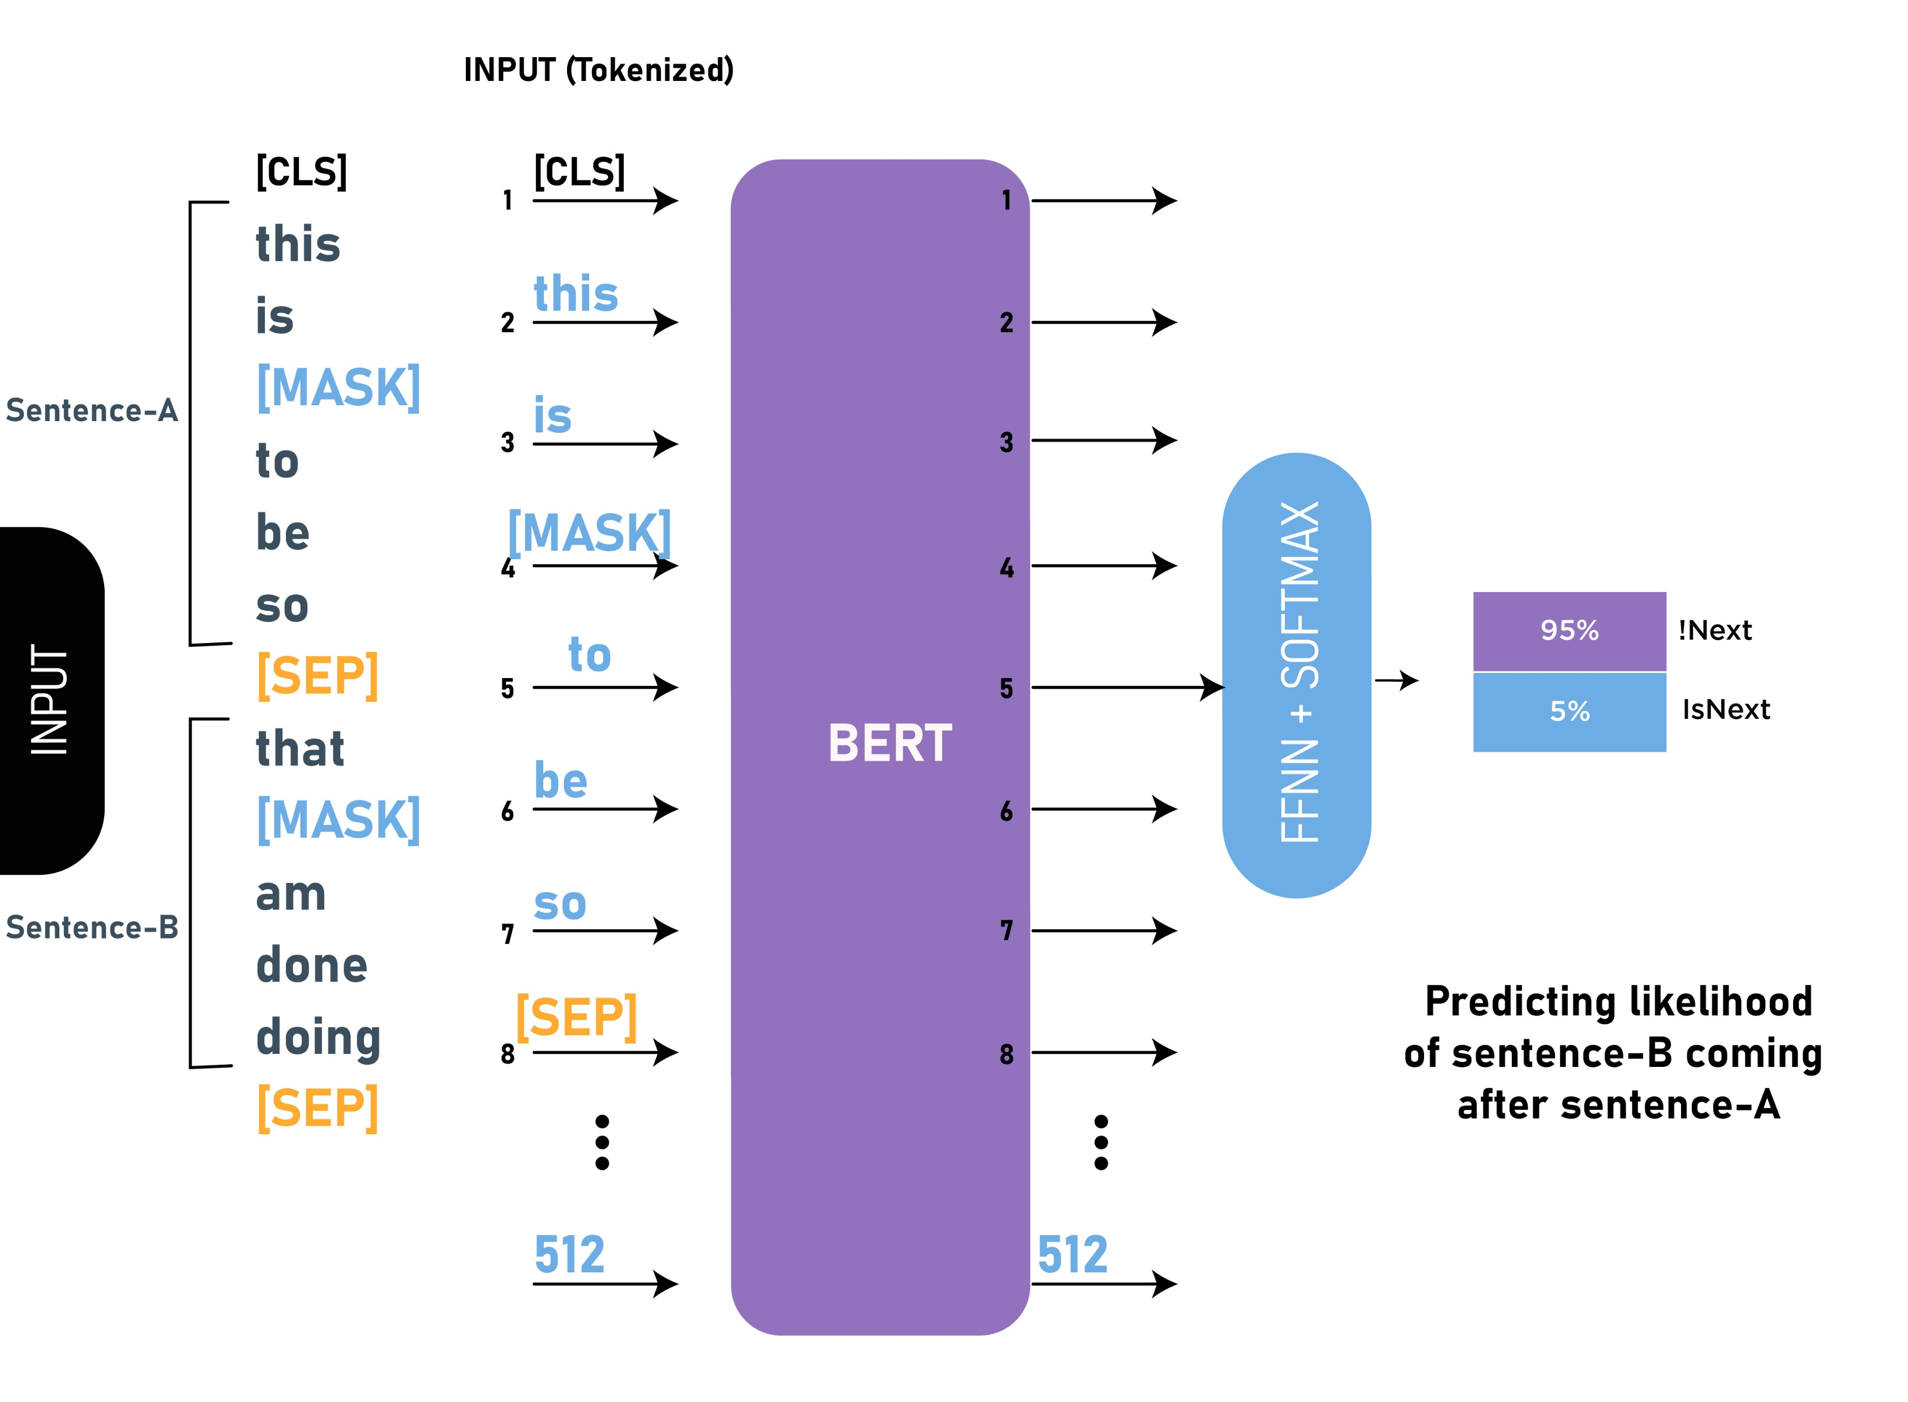
Next Sentence Prediction

Slide 13
Next Sentence Prediction
To help the model distinguish between the two sentences in training, the input is processed in the following way before entering the model:
A [CLS] token is inserted at the beginning of the first sentence and a [SEP] token is inserted at the end of each sentence.
A sentence embedding indicating Sentence A or Sentence B is added to each token. Sentence embeddings are similar in concept to token embeddings with a vocabulary of 2.
A positional embedding is added to each token to indicate its position in the sequence.

Slide 14
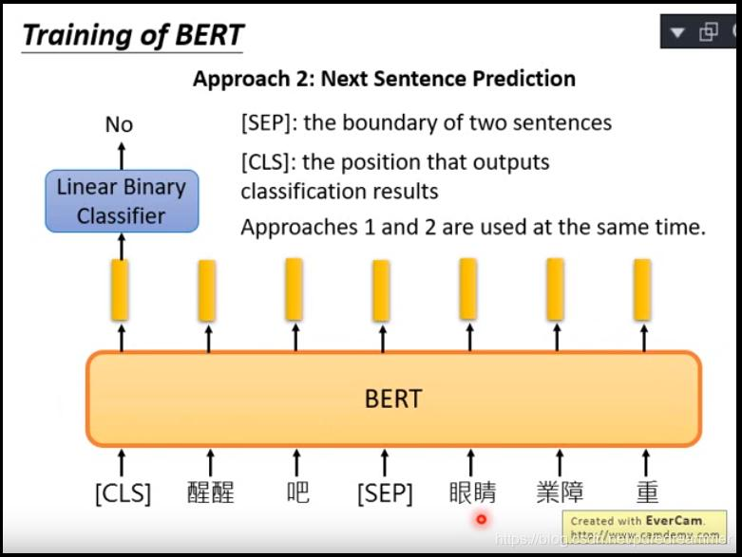
Next Sentence Prediction

Slide 15

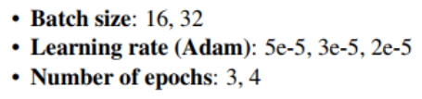
Fine-tuning with BERT
• Context vector 𝐶: Take the final hidden state corresponding to the first token in the input: [CLS].
• Transform to a probability distribution of the class labels:

Slide 16
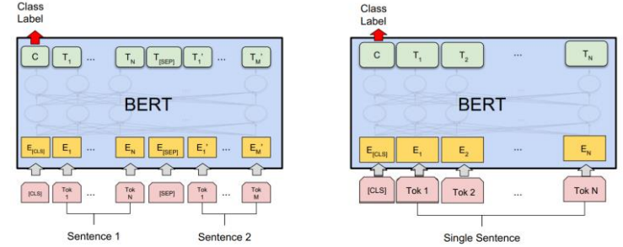
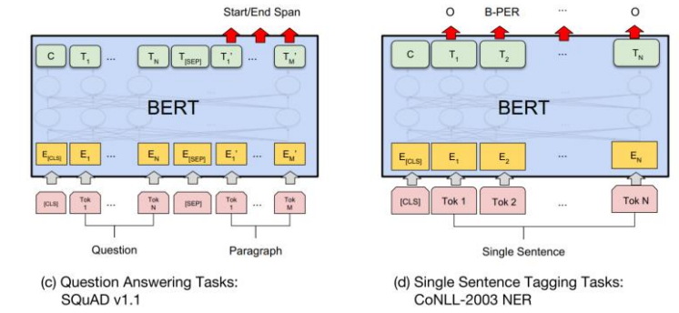
Fine-tuning with BERT

Slide 17
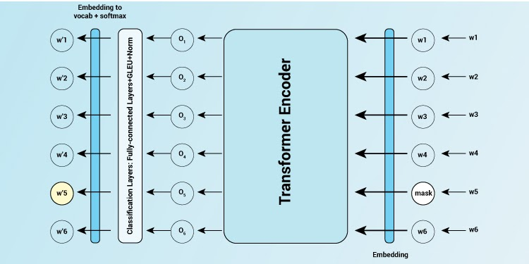
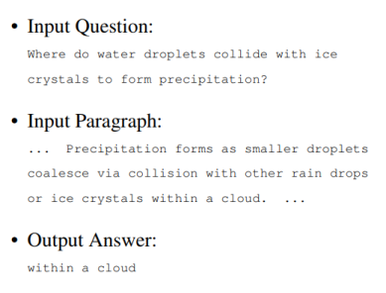
BERT in a Nutshell

Slide 18

Mathematical process
The Neural Attention Mechanism: Neural attention is a neural network component prevalent in contemporary state-of-the-art NLP models such as BERT.
Given a query q and a set of n items {X₁,X₂,……….X_{n} } , the attention mechanism induces a probability distribution α over the item set and then produces an expectation (weighted sum) of the items as the output. Intuitively, attention makes a soft selection of which item X₁ is the best fit for the query q. More formally, each item X_{i} represented by two vectors: key k_{i} and value v_{i}.
The key k_{i} is used to determine the distribution α via an inner product with the query vector q, normalized by a softmax:

Slide 19



Mathematical process
The output y is then the expectation over the value vectors v₁
Method: Attention Heads as Simple Classifiers.
if α(w,h) denotes the attention distribution of head h when BERT is run over the sequence of words w={w₁,w₂,……….w_{n} } we find the most-attended-to word
for each position 1 ≤ j ≤ n. If is the subset of the input expressing the annotated relationship, the precision score for the head is computed as

Slide 20
Difference with Other Neural Networks
BERT uses transformers archtecture of neural network so parallelization can be very helpful whereas the other (ELMO and ULMfit) uses LSTM
BERT is purely Bi-directional, GPT is unidirectional and ELMo is semi-bidirectional.
GPT is trained on the BooksCorpus (800M words); BERT is trained on the BooksCorpus (800M words) and Wikipedia (2,500M words).
For sentiment analysis or question answering tasks, to use BERT, the users have to train the model on a separate layer on sentence encodings. However, GPT-3 uses a few-shot learning process on the input token to predict the output result.

Slide 21
Difference with Other Neural Networks
While the transformer includes two separate mechanisms — encoder and decoder, the BERT model only works on encoding mechanisms to generate a language model; however, the GPT-3 combines encoding as well as decoding process to get a transformer decoder for producing text.
Being trained on 175 billion parameters, GPT-3 becomes 470 times bigger in size than BERT-Large.
BERT trains the language model transformers in both directions while the OPEN AI GPT context trains it only left to right.
While BERT requires an elaborated fine-tuning process where users have to gather data of examples to train the model for specific downstream tasks, GPT-3’s text-in and text-out API allows the users to reprogram it using instructions and access it.

Slide 22
Difference with Other Neural Networks
While BERTs use transformers to train language models, LSTMs are used to train Language models and finetune for classification
BERT, in contrast to Bidirectional LSTMs, can observe the entire sequence at once, in effect allowing to condition the hidden state on the entire sequence is probably contributing to this.
While GPT-3 is commercially available via an API, but not open-sourced, BERT has been an open-source model since its inception that allows users to fine-tune it according to their needs.

Slide 23


Text Generation with Bert
BERT based Text Generation applies one of the two pretraining steps of BERT, masked word prediction, for text generation. Masked word prediction in BERT pretraining looks like:
Actually, the model outputs confidence for every word in the dictionary. Thus, by choosing the “incorrect” word with the highest confidence, one can replace a word in a sentence hopefully without any grammatical or semantic incorrectness.
Here is a single step of word replacement at a random position.

Slide 24
Bert in Search Engine
Google Search has begun to use Google’s transformer neural network BERT from 2019 for search queries in over 70 languages.
The introduction of transformer neural networks to Google Search means that queries where words such as ‘from’ or ‘to’ affect the meaning are better understood by Google. Users can search in more natural English rather than adapting their search query to what they think Google will understand.
An example from Google’s blog is the query “2019 brazil traveler to USA need a visa.” The position of the word ‘to’ is very important for the correct interpretation of the query. The previous implementation of Google Search was not able to pick up this nuance and returned results about USA citizens traveling to Brazil, whereas the transformer model returns much more relevant pages.

Slide 25

Bert in Search Engine

Slide 26
Thank You

